Slide 1


DEPARTEMEN SISTEM INFORMASI
Fak. Teknologi Elektro & Informatika Cerdas
IW184301
DATABASE SYSTEMS
Chapter 02
IS Planning & DB Design Process
Prof. Ir. Arif Djunaidy, M.Sc., Ph.D.
adjunaidy@is.its.ac.id
adjunaidy@gmail.com

Slide 2
Learning Objectives & Book Reading
Learning Objectives - To Understand:
the life cycle of a systems development project, with an emphasis on the purpose of database analysis, design, and implementation activities
the prototyping and agile-development approaches to database and application development
the roles of individuals who design, implement, use, and administer databases
the differences among external, conceptual, and internal schemas and the reasons for the three-schema architecture for databases
Book reading:
Hoffer, Chapter 1
Connolly, Chapter 9
IS Planning & DB Design Process
Chapter 02 / 2

Slide 3
Outline
Information Systems Planning
Information Systems Architecture
Information Engineering & Rapid Application Development
Database Planning
System Definition
Requirements Formulation & Analysis
Database Design Process
Conceptual Database Design
Logical Database Design
Physical Database Design
IS Planning & DB Design Process
Chapter 02 / 3

Slide 4
Information Systems Planning (1)
Scope of IS is now the entire organization
Sometimes called “enterprise-wide” computing or “Information Architecture”
Problem: isolated groups in an organization start their own databases and it becomes impossible to find out who has what information, where there are overlaps, and to assess the accuracy of the information
IS Planning & DB Design Process
Chapter 02 / 4

Slide 5
Information Systems Planning (2)
To support enterprise-wide computing, there must be enterprise-wide information planning
One framework for thinking about and planning for enterprise-wide computing is an Information Systems Architecture or ISA
Most organizations do NOT have such an architecture
IS Planning & DB Design Process
Chapter 02 / 5

Slide 6
Outline
Information Systems Planning
Information Systems Architecture
Information Engineering & Rapid Application Development
Database Planning
System Definition
Requirements Formulation & Analysis
Database Design Process
Conceptual Database Design
Logical Database Design
Physical Database Design
IS Planning & DB Design Process
Chapter 02 / 6

Slide 7
Information System Architecture (1)
An ISA is a “conceptual blueprint or plan that expresses the desired future structure for information systems in an organization”
It provides a “context within which managers throughout the organization can make consistent decisions concerning their information systems”
IS Planning & DB Design Process
Chapter 02 / 7

Slide 8
Information System Architecture (2)
Benefits of ISA:
“Provides a basis for strategic planning of IS
Provides a basis for communicating with top management and a context for budget decisions concerning IS
Provides a unifying concept for the various stakeholders in information systems.
Communicates the overall direction for information technology and a context for decisions in this area
Helps achieve information integration when systems are distributed (increasing important in a global economy)
Provides a basis for evaluating technology options (for example, downsizing and distributed processing)
IS Planning & DB Design Process
Chapter 02 / 8

Slide 9
TOGAF vs Zachman Frameworks
The TOGAF framework provides a systematic approach for defining the process of creating or improving an Enterprise Architecture. With its Architecture Development Method (ADM) , the framework offers a process for implementing the decision choices in order to produce your desired model
The Zachman Framework, on the other hand, is more of is an ontology—a structured set of expressions that describe how artifacts can be categorized, and thus created, operated, and changed. Unlike TOGAF, Zachman uses various enterprise perspectives in order to scope, define, and plan details regarding individual subsets of your enterprise system
IS Planning & DB Design Process
Chapter 02 / 9

Slide 10
Zachman Framework (1)
Zachman ISA Framework components
Data
The “What” of the information system
Process/Function
The “How” of the information system
Network
The “Where” of the information system
People
Who performs processes and are the source and receiver of data and information.
Events and Points in Time
When processes are performed
Reasons/Motivation
Why: For events and rules that govern processing
IS Planning & DB Design Process
Chapter 02 / 10

Slide 11
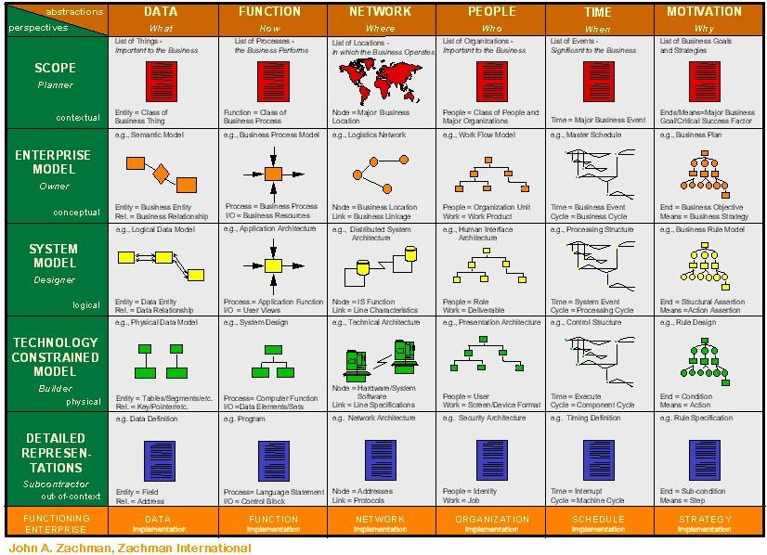
Zachman Framework (2)
IS Planning & DB Design Process
Chapter 02 / 11

Slide 12
Information System Architecture (3)
Six roles or perspectives of the Data, Process and Network components
Business scope (Owner)
Business model (Architect)
Information systems model (Designer)
Technology model (Builder)
Technology definition (Contractor)
Information system (User)
IS Planning & DB Design Process
Chapter 02 / 12

Slide 13
Information System Architecture (4)
Data Process Network
List of locations in
which the business
operates
List of entities
important to
the business
List of processes
or functions that
the business
performs
1. Enterprise Scope
(Owner)
IS Planning & DB Design Process
Chapter 02 / 13

Slide 14
Information System Architecture (5)
Data Process Network
Business entities and
their relationships
Function and process
decomposition
Communications links
between business
locations
2. Enterprise Model
(Architect)
IS Planning & DB Design Process
Chapter 02 / 14

Slide 15
Information System Architecture (6)
Data Process Network
Distribution Network
Model of the business
data and their
relationships (ERD in
Database design)
Flows between
application processes
3. Information System Model
(Designer)
IS Planning & DB Design Process
Chapter 02 / 15

Slide 16
Information System Architecture (7)
Data Process Network
Database Design (logical)
Process specifications
Database Design
4. Technology Constrained Model
(Builder)
IS Planning & DB Design Process
Chapter 02 / 16

Slide 17
Information System Architecture (8)
Data Process Network
Database Schema
and subschema
definition
Program Code and
control blocks
Configuration
definition/ Network
Architecture
5. Technology Definition/
Detailed Representations
(Contractor)
IS Planning & DB Design Process
Chapter 02 / 17

Slide 18
Information System Architecture (9)
Data Process Network
Implemented
Database and
information
Implemented
Application
Programs
Current
System
Configuration
6. Functioning Enterprise
(User)
IS Planning & DB Design Process
Chapter 02 / 18

Slide 19
Outline
Information Systems Planning
Information Systems Architecture
Information Engineering & Rapid Application Development
Database Planning
System Definition
Requirements Formulation & Analysis
Database Design Process
Conceptual Database Design
Logical Database Design
Physical Database Design
IS Planning & DB Design Process
Chapter 02 / 19

Slide 20
Information Engineering (1)
A formal methodology that is used to create and maintain information systems
Starts with the Business Model and works in a Top-Down fashion to build supporting data models and process models for that business model
IS Planning & DB Design Process
Chapter 02 / 20

Slide 21
Information Engineering (2)
Planning
Analysis
1. Identify Strategic Planning
Factors
a. Goals
b. Critical Success Factors
c. Problem Areas
2. Identify Corporate Planning
Objects
a. Org. Units
b. Locations
c. Business Functions
d. Entity types
3. Develop Enterprise Model
a. Function decomposition
b. Entity-Relationship
Diagram
c. Planning Matrices
Design
1. Develop Conceptual
Model
(detailed E-R Diagram)
2. Develop Process
Models
(data flow diagrams)
Implementation
1. Design Databases
(normalized relations)
2. Design Processes
a. Action Diagrams
b. User Interfaces:
menus, screens,
reports
1. Build database definitions
(tables, indexes, etc.)
2. Generate Applications
(program code, control
blocks, etc.)
IS Planning & DB Design Process
Chapter 02 / 21

Slide 22
Rapid Application Development
One more recent, and very popular, development methods is RAD Prototyping
Conceptual data
modeling
Logical data
modeling
Identify Problem
Initial requirements
Develop Prototype
Physical database
Design and definition
Convert to Operational System
Working
Prototype
New Requirements
Problems
Implement and use Prototype
Revise and enhance Prototype
Next Version
IS Planning & DB Design Process
Chapter 02 / 22

Slide 23
Outline
Information Systems Planning
Information Architecture
Information Systems Architecture
Information Engineering & Rapid Application Development
Database Planning
System Definition
Requirements Formulation & Analysis
Database Design Process
Conceptual Database Design
Logical Database Design
Physical Database Design
IS Planning & DB Design Process
Chapter 02 / 23

Slide 24
Database Planning (1)
Database Planning
The management activities that allow the stages of the database system development lifecycle to be realized as efficiently and effectively as
Database planning must be integrated with the overall IS strategy of the organization. There are three main issues involved in formulating an IS strategy
identification of enterprise plans and goals with subsequent determination of information systems needs;
evaluation of current information systems to determine existing strengths and weaknesses;
appraisal of IT opportunities that might yield competitive advantage.
IS Planning & DB Design Process
Chapter 02 / 24

Slide 25
Database Planning (2)
An important first step in database planning is to clearly define the mission statement for the database system
The mission statement defines the major aims of the database system
A mission statement helps to clarify the purpose of the database system and provide a clearer path towards the efficient and effective creation of the required database system
Once the mission statement is defined, the next activity involves identifying the mission objectives.
Each mission objective should identify a particular task that the database system must support
The assumption is that if the database system supports the mission objectives then the mission statement should be met
IS Planning & DB Design Process
Chapter 02 / 25

Slide 26
Database Planning (3)
Database planning should also include the development of standards that govern how data will be collected, how the format should be specified, what necessary documentation will be needed, and how design and implementation should proceed
standards can be very time-consuming to develop and maintain, requiring resources to set them up initially, and to continue maintaining them
a well-designed set of standards provides a basis for training staff and measuring quality control, and can ensure that work conforms to a pattern, irrespective of staff skills and experience
For example, specific rules may govern how data items can be named in the data dictionary, which in turn may prevent both redundancy and inconsistency
IS Planning & DB Design Process
Chapter 02 / 26

Slide 27
Outline
Information Systems Planning
Information Architecture
Information Systems Architecture
Information Engineering & Rapid Application Development
Database Planning
System Definition
Requirements Formulation & Analysis
Database Design Process
Conceptual Database Design
Logical Database Design
Physical Database Design
IS Planning & DB Design Process
Chapter 02 / 27

Slide 28
System Definition (1)
System Definition
Describes the scope and boundaries of the database application and the major user views
Before attempting to design a database system, it is essential that we first identify the boundaries of the system that we are investigating and how it interfaces with other parts of the organization’s information system.
It is important that we include within our system boundaries not only the current users and application areas, but also future users and applications.
IS Planning & DB Design Process
Chapter 02 / 28

Slide 29
System Definition (2)
User Views
Defines what is required of a database system from the perspective of a particular job role (such as Manager or Supervisor) or enterprise application area (such as marketing, personnel, or stock control)
Identifying user views is an important aspect of developing a database system because it helps to ensure that no major users of the database are forgotten when developing the requirements for the new database system
A user view defines what is required of a database system in terms of the data to be held and the transactions to be performed on the data (in other words, what the users will do with the data)
IS Planning & DB Design Process
Chapter 02 / 29

Slide 30
System Definition (3)
The requirements of a user view may be distinct to that view or overlap with other views
IS Planning & DB Design Process
Chapter 02 / 30

Slide 31
Outline
Information Systems Planning
Information Architecture
Information Systems Architecture
Information Engineering & Rapid Application Development
Database Planning
System Definition
Requirements Formulation & Analysis
Database Design Process
Conceptual Database Design
Logical Database Design
Physical Database Design
IS Planning & DB Design Process
Chapter 02 / 31

Slide 32
Requirements Formulation & Analysis (1)
Purpose: Identify and describe the data that are used by the organization
Results: Metadata identified, Data Dictionary, Conceptual Model → ER diagram
Systems Analysis Process
Examine all of the information sources used in existing applications
Identify the characteristics of each data element: numeric, text, date/time, etc.
Examine the tasks carried out using the information
Examine results or reports created using the information
IS Planning & DB Design Process
Chapter 02 / 32

Slide 33
Requirements Formulation & Analysis (2)
Requirements collection and analysis
The process of collecting and analyzing information about the part of the organization that is to be supported by the database system, and using this information to identify the requirements for the new system.
There are many techniques for gathering this information, called fact-finding techniques, which we discuss in detail in next Chapter. Information is gathered for each major user view (that is, job role or enterprise application area), including:
a description of the data used or generated;
the details of how data is to be used or generated;
any additional requirements for the new database system.
IS Planning & DB Design Process
Chapter 02 / 33

Slide 34
Requirements Formulation & Analysis (3)
This information is then analyzed to identify the requirements (or features) to be included in the new database system. These requirements are described in documents collectively referred to as requirements specifications for the new database system
Requirements collection and analysis is a preliminary stage to database design. The amount of data gathered depends on the nature of the problem and the policies of the enterprise
Identifying the required functionality for a database system is a critical activity, as systems with inadequate or incomplete functionality will annoy the users, which may lead to rejection or underutilization of the system.
IS Planning & DB Design Process
Chapter 02 / 34

Slide 35
Requirements Formulation & Analysis (4)
Another important activity associated with this stage is deciding how to deal with the situation where there is more than one user view for the database system. There are three main approaches to managing the requirements of a database system with multiple user views
the centralized approach;
the view integration approach;
a combination of both approaches.
IS Planning & DB Design Process
Chapter 02 / 35

Slide 36
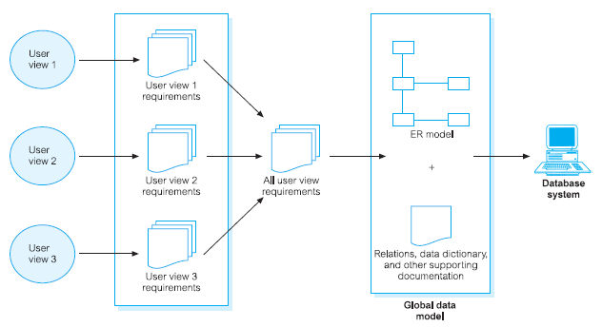
Centralized Approach (1)
IS Planning & DB Design Process
Chapter 02 / 36

Slide 37
Centralized Approach (2)
Requirements for each user view are merged into a single set of requirements for the new database system. A data model representing all user views is created during the database design stage.
The collection of user views is given a name that provides some indication of the functional area covered by all the merged user views
In the database design stage, a global data model is created, which represents all user views
The global data model is composed of diagrams and documentation that formally describe the data requirements of the users
Generally, this approach is preferred when there is a significant overlap in requirements for each user view and the database system is not overly complex
IS Planning & DB Design Process
Chapter 02 / 37

Slide 38
View Integration Approach (1)
IS Planning & DB Design Process
Chapter 02 / 38

Slide 39
View Integration Approach (2)
Requirements for each user view remain as separate lists. Data models representing each user view are created and then merged later during the database design stage
The view integration approach involves leaving the requirements for each user view as separate lists of requirements
In the database design stage, a data model for each user view is created first
A data model that represents a single user view (or a subset of all user views) is called a local data model
The local data models are then merged at a later stage of database design to produce a global data model, which represents all user requirements for the database
IS Planning & DB Design Process
Chapter 02 / 39

Slide 40
Outline
Information Systems Planning
Information Systems Architecture
Information Engineering & Rapid Application Development
Database Planning
System Definition
Requirements Formulation & Analysis
Database Design Process
Conceptual Database Design
Logical Database Design
Physical Database Design
IS Planning & DB Design Process
Chapter 02 / 40

Slide 41
Database Design Process
Application 1
Application 2
Application 3
Application 4
External
Model
External
Model
External
Model
External
Model
Application 1
Conceptual
requirements
Application 2
Conceptual
requirements
Conceptual
Model
Logical
Model
Physical Model
Application 3
Conceptual
requirements
Application 4
Conceptual
requirements
Conceptual
Design
Logical
Design
Physical
Design
IS Planning & DB Design Process
Pokok Bahasan 02 / 41

Slide 42
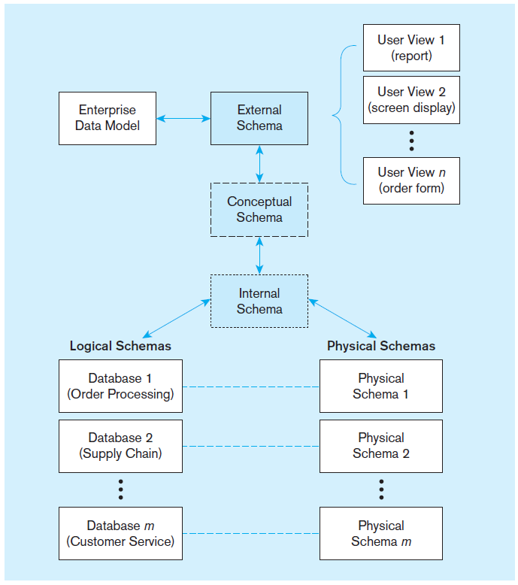
ANSI-SPARC (Three-schema) Architecture for Database Development
External schema This is the view (or views) of managers and other employees who are the database users
Conceptual schema This schema combines the different external views into a single, coherent, and comprehensive definition of the enterprise’s data
Internal schema An internal schema today really consists of two separate schemas: a logical schema and a physical schema
IS Planning & DB Design Process
Chapter 02 / 42

Slide 43
Importance of Database Design
Database design is an iterative process, which has a starting point and an almost endless procession of refinements
They should be viewed as learning processes. As the designers come to understand the workings of the enterprise and the meanings of its data, and express that understanding in the selected data models
In particular, conceptual, and logical database designs are critical to the overall success of the system. If the designs are not a true representation of the enterprise, it will be difficult, if not impossible, to define all the required user views or to maintain database integrity
Therefore, it is worthwhile spending the time and energy necessary to produce the best possible design
IS Planning & DB Design Process
Chapter 02 / 43

Slide 44
Database Design (1)
Database design
The process of creating a design that will support the enterprise’s mission statement and mission objectives for the required database system
The two main approaches to the design of a database are referred to as ‘bottom-up’ and ‘top-down’
IS Planning & DB Design Process
Chapter 02 / 44

Slide 45
Database Design (2)
The bottom-up approach begins at the fundamental level of attributes (that is, properties of entities and relationships), which through analysis of the associations between attributes, are grouped into relations that represent types of entities and relationships between entities
The bottom-up approach is appropriate for the design of simple databases with a relatively small number of attributes.
However, this approach becomes difficult when applied to the design of more complex databases with a larger number of attributes, where it is difficult to establish all the functional dependencies between the attributes.
IS Planning & DB Design Process
Chapter 02/ 45

Slide 46
Database Design (3)
A more appropriate strategy for the design of complex databases is to use the top-down approach.
This approach starts with the development of data models that contain a few high-level entities and relationships and then applies successive top-down refinements to identify lower-level entities, relationships, and the associated attributes
The top-down approach is illustrated using the concepts of the Entity–Relationship (ER) model, beginning with the identification of entities and relationships between the entities, which are of interest to the organization
IS Planning & DB Design Process
Chapter 02 / 46

Slide 47
Database Design (4)
There are other approaches to database design such as the mixed strategy approach.
The mixed strategy approach uses both the bottom-up and top-down approach for various parts of the model before finally combining all parts together.
IS Planning & DB Design Process
Chapter 02 / 47

Slide 48
Outline
Information Systems Planning
Information Architecture
Information Systems Architecture
Information Engineering & Rapid Application Development
Database Planning
System Definition
Requirements Formulation & Analysis
Database Design Process
Conceptual Database Design
Logical Database Design
Physical Database Design
IS Planning & DB Design Process
Chapter 02 / 48

Slide 49
Conceptual Database Design
The process of constructing a model of the data used in an enterprise, independent of all physical considerations.
The first phase of database design is called conceptual database design, and involves the creation of a conceptual data model of the part of the enterprise that we are interested in modeling
The data model is built using the information documented in the users’ requirements specification.
Conceptual database design is entirely independent of imple- mentation details such as the target DBMS software, application programs, programming languages, hardware platform, or any other physical considerations
Throughout the process of developing a conceptual data model, the model is tested and validated against the users’ requirements
IS Planning & DB Design Process
Chapter 02 / 49

Slide 50
Data Modeling (1)
The two main purposes of data modeling are to assist in the understanding of the meaning (semantics) of the data and to facilitate communication about the information requirements. Building a data model requires answering questions about entities, relationships, and attributes.
A data model makes it easier to understand the meaning of the data, and thus we model data to ensure that we understand:
each user’s perspective of the data;
the nature of the data itself, independent of its physical representations;
the use of data across user views.
IS Planning & DB Design Process
Chapter 02 / 50

Slide 51
Data Modeling (2)
Data models can be used to convey the designer’s understanding of the information requirements of the enterprise.
Provided both parties are familiar with the notation used in the model, it will support communication between the users and designers.
Increasingly, enterprises are standardizing the way that they model data by selecting a particular approach to data modeling and using it throughout their database development projects.
The most popular high-level data model used in database design, and the one we use in this book, is based on the concepts of the Entity–Relationship (ER) model.
IS Planning & DB Design Process
Chapter 02 / 51

Slide 52
Criteria to produce an optimal data model (1)
Criteria | Description
Structural validity | Consistency with the way the enterprise defines and organizes information.
Simplicity | Ease of understanding by IS professionals and non-technical users.
Expressibility | Ability to distinguish between different data, relationships between data, and constraints.
Nonredundancy | exclusion of extraneous information; in particular, the representation of any one piece of information exactly once.
Shareability | Not specific to any particular application or technology and thereby usable by many.
IS Planning & DB Design Process
Chapter 02 / 52

Slide 53
Criteria to produce an optimal data model (2)
Criteria | Description
Extensibility | Ability to evolve to support new requirements with minimal effect on existing users.
Integrity | Consistency with the way the enterprise uses and manages information.
Diagrammatic representation | Ability to represent a model using an easily understood diagrammatic notation.
IS Planning & DB Design Process
Chapter 02 / 53

Slide 54
Outline
Information Systems Planning
Information Architecture
Information Systems Architecture
Information Engineering & Rapid Application Development
Database Planning
System Definition
Requirements Formulation & Analysis
Database Design Process
Conceptual Database Design
Logical Database Design
Physical Database Design
IS Planning & DB Design Process
Chapter 02 / 54

Slide 55
Logical Database Design (1)
The process of constructing a model of the data used in an enterprise based on a specific data model, but independent of a particular DBMS and other physical considerations
The second phase of database design is called logical database design, which results in the creation of a logical data model of the part of the enterprise that we interested in modeling
The conceptual data model created in the previous phase is refined and mapped on to a logical data model
The logical data model is based on the target data model for the database (for example, the relational data model)
IS Planning & DB Design Process
Chapter 02 / 55

Slide 56
Logical Database Design (2)
Throughout the process of developing a logical data model, the model is tested and validated against the users’ requirements.
The logical data model should also be examined to ensure that it supports the transactions specified by the users.
The logical model also serves an important role during the operational maintenance stage of the database system development lifecycle.
Properly maintained and kept up to date, the data model allows future changes to application programs or data to be accurately and efficiently represented by the database.
The technique of normalization is used to test the correctness of a logical data model. Normalization ensures that the relations derived from the data model do not display data redundancy, which can cause update anomalies when implemented.
IS Planning & DB Design Process
Chapter 02 / 56

Slide 57
Outline
Information Systems Planning
Information Architecture
Information Systems Architecture
Information Engineering & Rapid Application Development
Database Planning
System Definition
Requirements Formulation & Analysis
Database Design Process
Conceptual Database Design
Logical Database Design
Physical Database Design
IS Planning & DB Design Process
Chapter 02 / 57

Slide 58
Physical Database Design (1)
The process of producing a description of the implementation of the database on secondary storage; it describes the base relations, file organizations, and indexes used to achieve efficient access to the data, and any associated integrity constraints and security measures.
Physical database design is the third and final phase of the database design process, during which the designer decides how the database is to be implemented.
Although this structure is DBMS-independent, it is developed in accordance with a particular data model such as the relational
However, in developing the physical database design, we must first identify the target DBMS. Therefore, physical design is tailored to a specific DBMS system.
IS Planning & DB Design Process
Chapter 02 / 58

Slide 59
Physical Database Design (2)
In general, the main aim of physical database design is to describe how we intend to physically implement the logical database design. For the relational model, this involves:
creating a set of relational tables and the constraints on these tables from the information presented in the logical data model;
identifying the specific storage structures and access methods for the data to achieve an optimum performance for the database system;
designing security protection for the system.
IS Planning & DB Design Process
Chapter 02 / 59

Slide 60
Physical Database Design (3)
Ideally, conceptual and logical database design for larger systems should be separated from physical design for three main reasons:
it deals with a different subject matter – the what, not the how;
it is performed at a different time – the what must be understood before the how can be determined;
it requires different skills, which are often found in different people.
IS Planning & DB Design Process
Chapter 02 / 60

Slide 61

End of Chapter 02

